Slide 1

Virtual Machines in
Cloud Computing
An analysis of virtualization mechanisms, hypervisor architectures, and hardware privilege execution models based on Chapter 5.

Slide 2
IT457
Cloud Computing
Week5_Lec2
Introduction to Virtualization

Slide 3
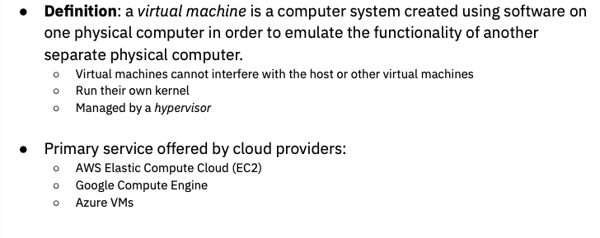
Virtual Machine

Slide 4
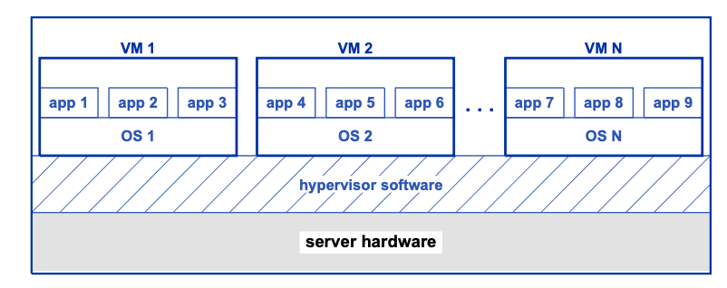
Hypervisor
load software onto a server
  Allows to create many VMs
Allow tenant (owner of VM)
  Boot OS on VM
  Use OS to launch apps
Software used for creating and managing VMs → a hypervisor.
Controlling the underlying hardware.
  Each VM the hypervisor creates is independent of other VMs.

Slide 5
SECTION 01
Approaches to Virtualization
Exploring Software Emulation, Para-virtualization, and Full Virtualization models.

Slide 6






Three Virtualization Models
Software Emulation
Para-virtualization
Full Virtualization
Translates hypothetical instructions via byte code interpreters. Provides portability across hardware but introduces high execution overhead.
Multiple OS’es to run on single PC/server
Replaces privileged OS instructions with hypervisor calls.
Offers near-native execution speed but requires modified operating system code.
Emulates commercial instruction sets seamlessly.
Allows unmodified guest operating systems to execute directly at hardware speed with isolation.

Slide 7


Emulation vs Para-Virtualization
Software Emulation Trade-offs
Para-Virtualization Trade-offs
Uses byte-code compilers and interpreters (like the Java Virtual Machine) to run software across heterogeneous CPUs.
Pioneered in the 1960s, a hypervisor moves processors among multiple guest OS instances directly on hardware.
Major Drawback: Requires altering guest operating system source code to replace I/O and privileged calls with hypervisor traps.
Major Drawback: Severe performance penalty from software translation makes it ineligible as a primary virtualization form in cloud data centers.

Slide 8
SECTION 02
Full Virtualization Architecture
Key properties and system organization of production cloud virtual machines.

Slide 9
Key Properties of Full Virtualization
Commercial Instruction Set Emulation: To the guest tenant, a VM is identical to physical hardware. Standard operating systems like Linux and Windows boot unaltered.
Isolated Facilities & Operation: Complete independence between VMs on the same server. Each guest OS acts as if it has exclusive control of memory, devices, and CPU cores.
Efficient Low-Overhead Execution: Almost all non-privileged instructions execute directly on physical CPUs at full native hardware speed.

Slide 10
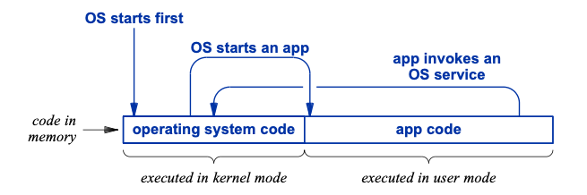
The question arises, how can an application running in a VM operate at hardware
speed?

Slide 11
SECTION 03
Processor Privilege & Execution
How hardware execution modes maintain speed and system protection.

Slide 12

Three Privilege Levels
Enforcing Hardware Privilege
Traditional operating systems rely on 2 hardware modes (Kernel Mode & User Mode). Cloud virtualization extends CPU hardware support to 3 distinct privilege levels:
3
1. Hypervisor Mode: Highest privilege; manages host resources and creates VMs.
hypervisor can create a VM and allocate memory to the VM.
2. Kernel Mode: Restricted privilege; guest OS manages its own memory & apps.
The operating system is restricted to the memory that has been allocated to its VM.
The operating system can run apps in the memory it has been allocated.
3. User Mode: Basic privilege; tenant applications execute natively.
Hardware Modes

Slide 13
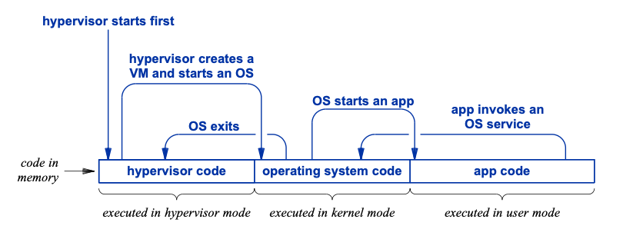
Extending to Hypervisor

Slide 14




Execution & State Transitions
2. Guest OS Start
4. System Call Trap
Hypervisor boots VM Guest OS into Kernel Mode within isolated memory boundaries.
App service call triggers hardware trap, switching CPU back to Kernel or Hypervisor mode.
1. Hypervisor Boot
3. App Launch
Hypervisor runs first in hypervisor mode to allocate memory and configure host hardware.
Guest OS launches app code in User Mode. Application executes at full hardware speed.

Slide 15


Hierarchy of Trust
Hypervisor Trust Level
Guest OS & App Sandboxing
Trusted completely. Manages host CPU cores, memory boundaries, and physical hardware interfaces.
Operating systems and user applications require lower trust levels enforceably restricted by CPU hardware modes.
Must correctly configure CPU hardware isolation mechanisms so no guest OS can breach its VM container or inspect adjacent memory.
If an app attempts unauthorized memory access or privileged commands, hardware automatically traps execution back to the governing layer.

